Slide 1
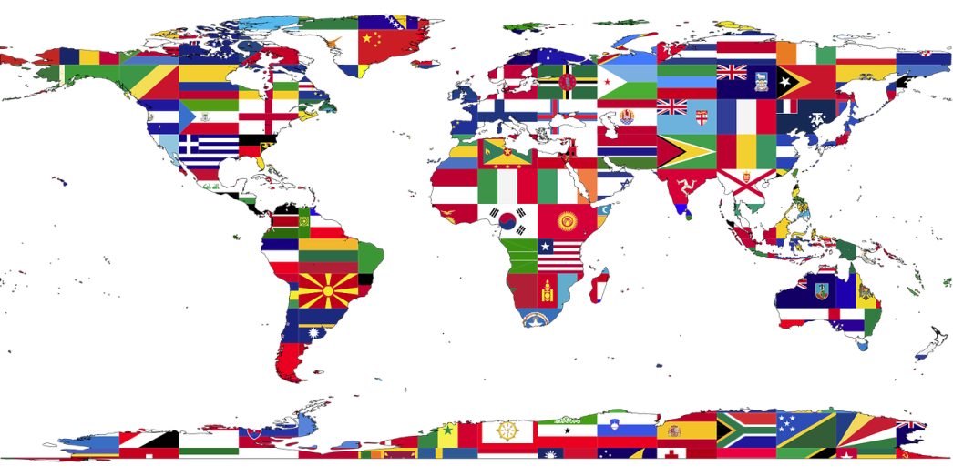
跨文化溝通之職場英文
by Christine 黃元怡

Slide 2
About me
學歷：美國波士頓大學教育科技與媒體碩士、清華大學外語系學士
現職：
＊ 東華書局產品經理
＊ 國立清華大學、國立臺灣科技大學英語講師
經歷：
＊ Pearson Longman專任英語教學顧問 / 行銷副理
＊ 美國Middlesex School專任教師
＊ 曼哈頓國際語文中心教學總監
＊ 銘傳大學講師、文化大學推廣教育部英語講師
＊ 康寧專校英語講師
＊ 台北市警察局少年隊英語講師
＊ 交通部英語講師
著作：
國語日報週刊 English Game 專欄作者
英語教學雙月刊Hello ！ E.T. 師德會訊 專欄作者
「國中英語閱讀通」(台灣培生出版社)
演講
清華大學、交通大學、中央大學、宜蘭大學、中華科大、勤益科大、僑光科大、虎尾科大、嘉義大學、基隆高中、興國中學、嘉華中學、靜修女中、東山高中等全國超過三十間校院

Slide 3
What is culture?

Slide 4
Cambridge Dictionary
the way of life, especially the general customs and beliefs, of particular group of people at a particular time

Slide 5
...when the acquisition of a foreign language is enhanced by critical cultural awareness (CCA), students leave the classroom equipped with the skills needed to participate in local and global communities due to a deeper level of cultural awareness and understanding.
Nugent, K. and Catalano, T. (2015). Critical cultural awareness in the foreign language classroom.

Slide 6
YouTube
https://www.youtube.com/watch?v=UTE0G9amZNk
https://www.youtube.com/watch?v=bdeFdFEbuqk

Slide 7
The OK hand gesture
In Brazil it can be synonymous with giving someone the middle finger.

Slide 8
The OK hand gesture
In Turkey, it means you are accusing someone of being a homosexual and is considered very bad. In Turkey, it is rude to point your finger at someone. ... Best to avoid it in Turkey.

Slide 9
15 Ways People Greet Each Other From Countries Around the World
https://www.youtube.com/watch?v=pe999mVg8qA

Slide 10
How Cultural Differences Affect Business
https://www.youtube.com/watch?v=zQvqDv4vbEg
Funny, But True: Cultural Differences
https://www.youtube.com/watch?v=2xJ_hbD4TQA

Slide 11
Stereotype?

Slide 12
Avoid Stereotypes
https://www.youtube.com/watch?v=XUO59Emi3eo&list=LLPqLKvVlVZv_aicbycNHN3A
Common Stereotypes About Americans
https://www.youtube.com/watch?v=NCTTc_2W7rA

Slide 13
I Am Not Your Asian Stereotype
https://www.youtube.com/watch?v=_pUtz75lNaw

Slide 14
台灣的禁忌! Taboos in TAIWAN!
https://www.youtube.com/watch?v=kwV-TjMyvo8

Slide 15
YouGlish
https://youglish.com/

Slide 16
跨文化溝通之職場英文
by Christine 黃元怡

